Slide 1
Completely Automate Managing Windows Software...Forever
Dan Franciscus @dan_franciscus

Slide 2

Who is this guy?
I am “Dan the Builder” on Twitter - @dan_franciscus.
Systems Engineer at the Institute for Advanced Study
Technologies – Windows, PowerShell, Puppet, VMware, Chocolatey
Freelance writer for various sites (4sysops, Techtarget, Ipswitch, CODE Magazine)
I have written A LOT about Chocolatey and PowerShell – winsysblog.com
Twitter – dan_franciscus
Github – dfranciscus
Email – dfranciscus@cnjcomputing.com

Slide 3
Agenda
What is Chocolatey?
Package internalizing
Upgrading Chocolatey client packages
Q&A

Slide 4


Slide 5
Friends don’t let friends install software with a GUI

Slide 6
Managing Windows software is a solved problem with Chocolatey
Yay!

Slide 7
My Chocolatey goals
Automate initial deployment of software to new end user machines
Automate upgrading software on existing machines
Enable end users to install software on their own
Very very very rarely have to do anything myself (remove human intervention)

Slide 8
What is Chocolatey?
Wrapper around Windows installers
Small client software and/or agent (service)
CLI or GUI
Community repository (thousands of software packages)
Uses PowerShell scripts to automate package management (c:\ProgramData\Chocolatey\helpers)

Slide 9
What is a Chocolatey package?
.nupkg file (Zip)
Installer files
.nuspec file (package metadata)
chocolateyInstall.ps1 (install logic)

Slide 10
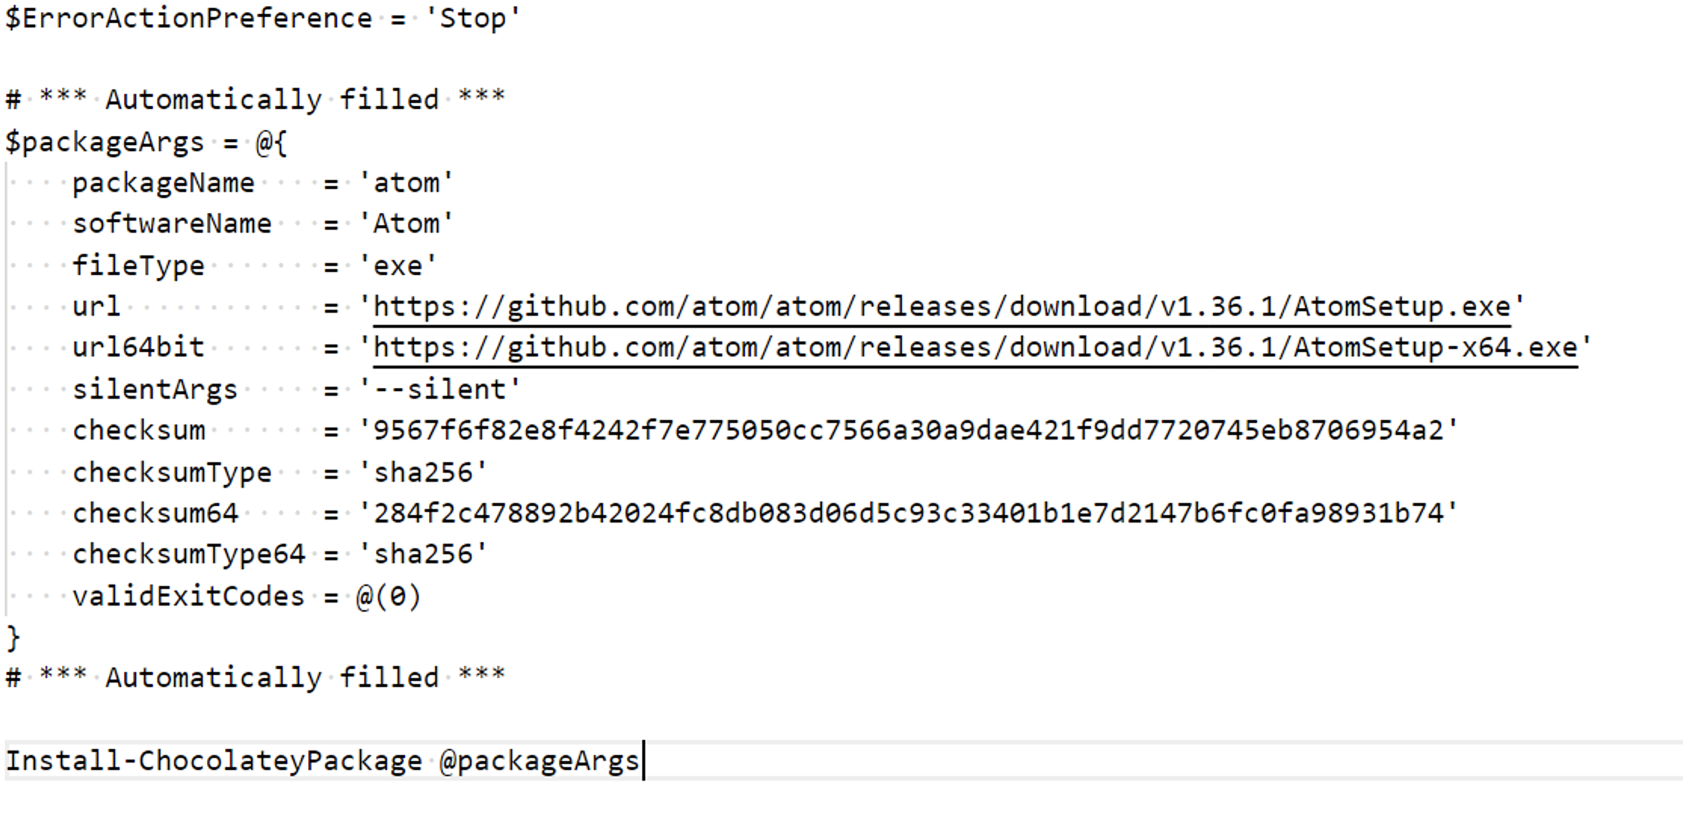
chocolateyInstall.ps1

Slide 11
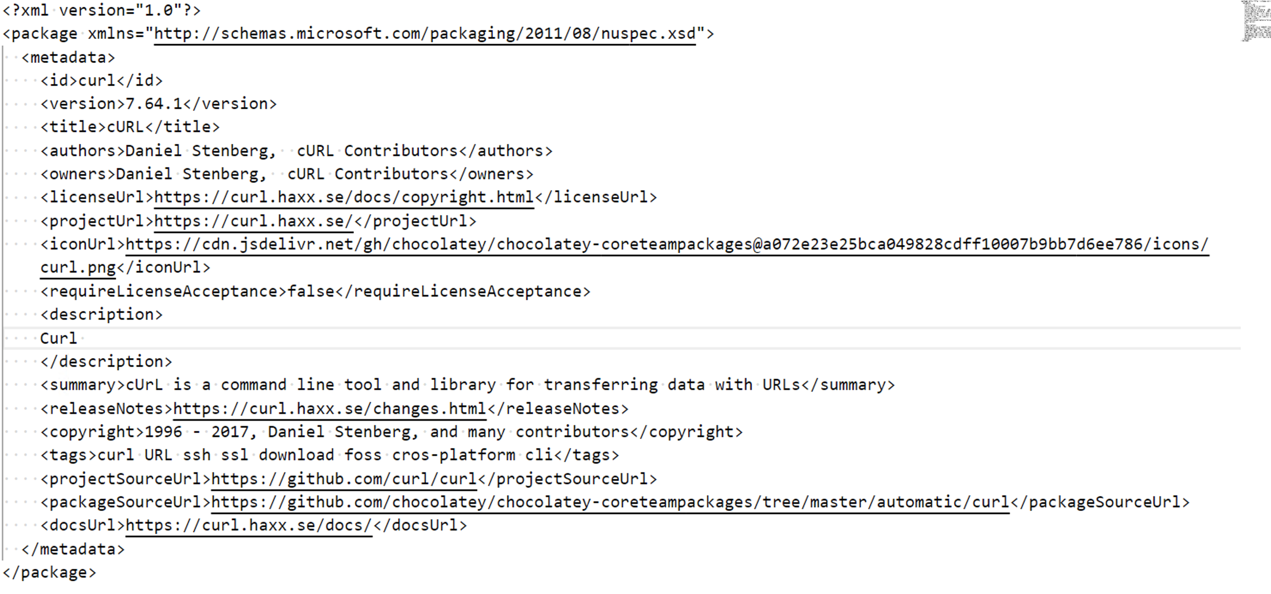
Nuspec file

Slide 12
Why use Chocolatey?
Universal CLI for installing software
Want to install 10 pieces of software with one command?
Want to upgrade all software on a system quickly?
Want to use PowerShell to manage software?
Want something that integrates with config management (Puppet, Ansible, Salt)?

Slide 13
Common Chocolatey commands
#list
choco list
#Install
choco install googlechrome -y
#Upgrade
choco upgrade googlechrome -y
#Uninstall
choco uninstall googlechrome -y

Slide 15
Package Internalizing

Slide 16
Community Repository
Maintained by Chocolatey staff and community members
Majority of popular packages available quickly after release
Most packages download installers directly from official distribution points
Moderated by Chocolatey

Slide 17
What is Internalizing?
Recompiling a Chocolatey package at a high level involves:
Downloading and unpacking the existing package.
Downloading the resources the package has and putting them in the package.
Editing the install script to point to the internal software.
Packaging it back up.
Pushing it to your internal server.
https://chocolatey.org/blog/internalize-packages

Slide 18
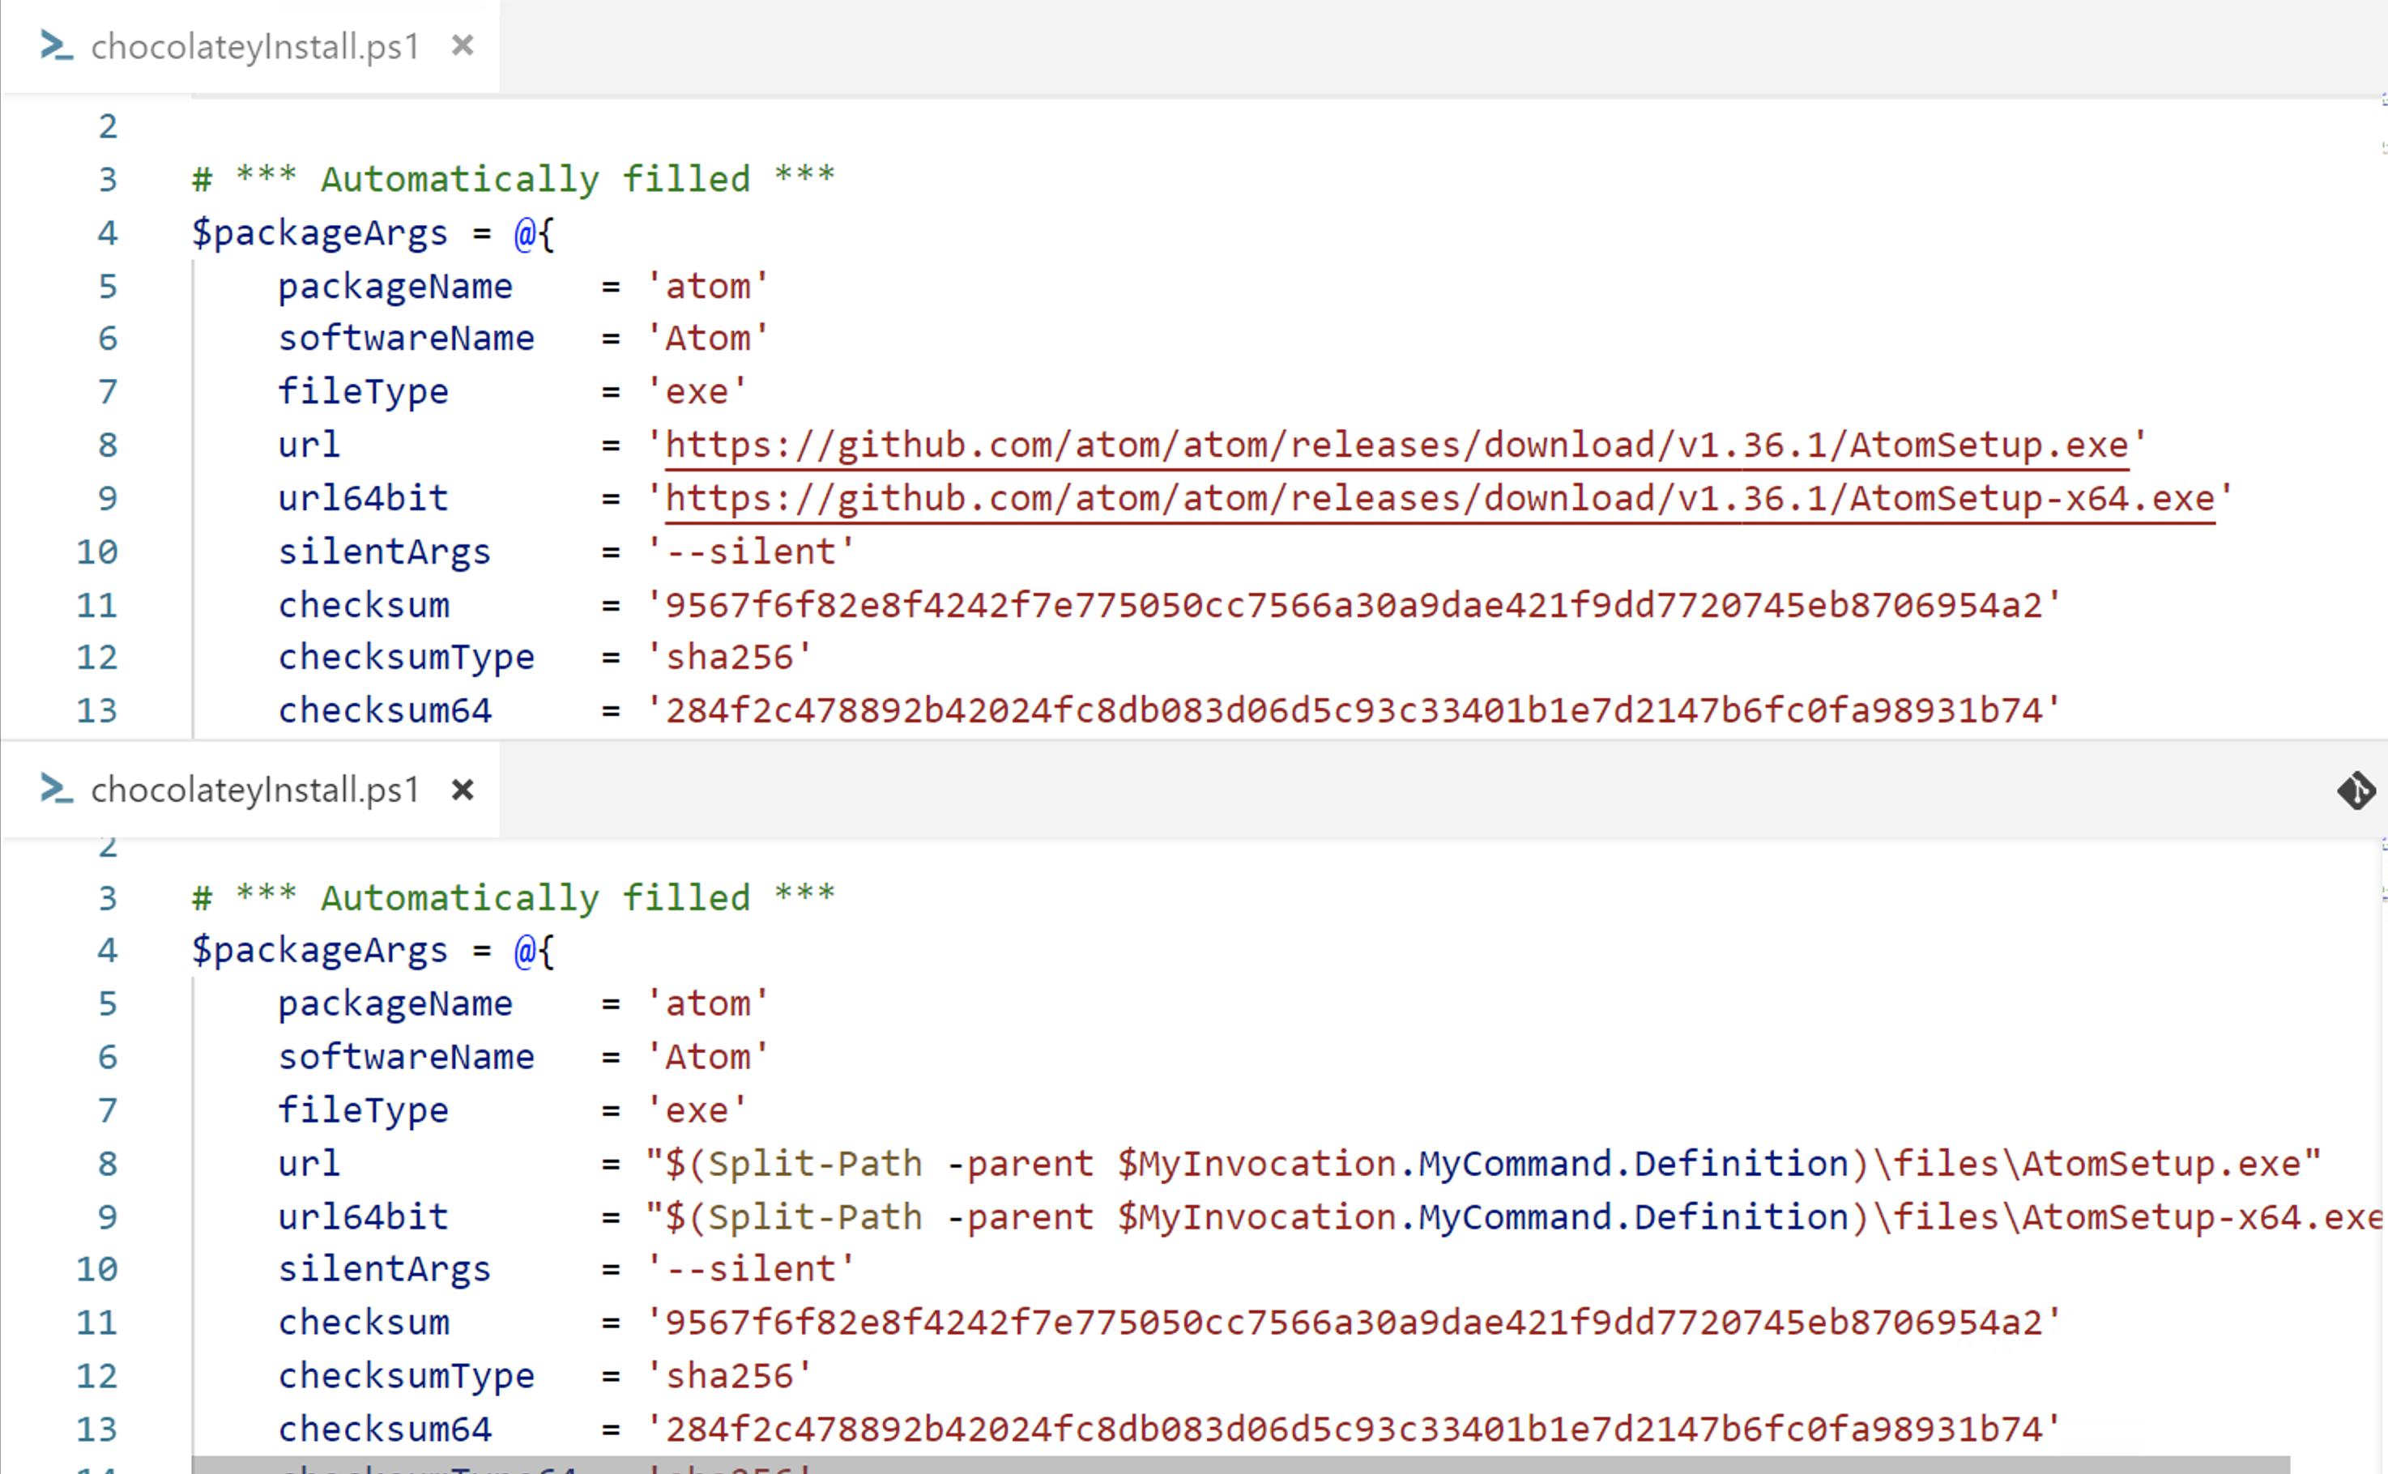
Internalized package

Slide 19
Package automation lifecycle
Internalize packages on test client
Test install
Schedule upgrade if needed
Run upgrade for all clients
New community package version released
Push to internal repo

Slide 20
Internal repositories
Various solutions – CIFS share, ProGet, Artifactory, Myget
I prefer Chocolatey server Puppet module (IIS)
Repos for unlicensed or free applications for end users (internalized packages)
Repos for licensed software (mostly packages we create)

Slide 21
Internalizing setup
Chocolatey community repository
Chocolatey test machine
Private repository

Slide 22
Chocolatey-Tools Module
https://github.com/dfranciscus/Chocolatey-tools
PowerShell wrapper around Chocolatey and Boxstarter
Helps with internalizing

Slide 23
Chocolatey commands for internalizing
Chocolatey Test Machine
Find outdated packages
Download and internalize packages
Test upgrading packages
Push packages to private repo
Chocolatey CLI commands | Chocolatey-tools module commands
choco outdated | Get-ChocoOutdatedPackage
choco download --internalize | Invoke-ChocoInternalizePackage
choco upgrade | Invoke-ChocoUpgradeIntPackage
choco push | Push-ChocoIntPackage
Notes:
-Tell story how your internalize script was crap and you had to write a module for this presentation

Slide 24
Internalizing with Chocolatey-tools module

Slide 25
Upgrading Packages

Slide 26
What is needed?
Chocolatey
PowerShell with Remoting and/or Boxstarter
Task Scheduler
… That’s it.

Slide 27
Upgrade requirements
Do not disrupt end users
By default, software upgraded on weekends
If certain software versions are released, schedule upgrade ASAP

Slide 28
Scheduling upgrades with PowerShell
Entire Windows fleet upgraded at once
Uses Scheduled tasks to run in background
Certain packages prompt scheduling upgrades that day (Google Chrome, Firefox) this is scheduled by hooking into internalization process

Slide 29
Using the pipeline for internalizing

Slide 30
Upgrading clients with PowerShell
PowerShell remoting script that uses Invoke-Command
Runs on all managed workstations simultaneously
Ability to exclude or include packages not already installed
Add our protected repo for upgrading packages and then remove from clients
Uses Test-PendingReboot to reboot if necessary
Log each packages output
Email results

Slide 31
Upgrading Chocolatey clients with PowerShell

Slide 32
Boxstarter
Uses Chocolatey packages
Can be used to install packages locally and remotely
Can point to a PowerShell script, text file or Gist as a package
Has other cmdlets to customize Windows
Reboot resilient

Slide 33
Invoke-BoxstarterRemoteUpgrade
Uses Boxstarter for pushing Chocolatey upgrade packages
Creates a dynamic script/package which includes any outdated packages and additional packages on demand.
Excludes packages

Slide 34
Upgrading Chocolatey clients with Boxstarter

Slide 35
When do I intervene?
Well uhh, when something breaks
When internalizing a package fails ☹
Package fails to upgrade on a client
Creating a non-community package
Email alerts configured to tell us when something went wrong

Slide 36
Q&A
http://winsysblog.com
Twitter – dan_franciscus
Github – dfranciscus
Email – dfranciscus@cnjcomputing.com

